Slide 1
LCA Activities within HERWINGT
EASN Conference – Ecodesign in Clean Aviation
Day 3 – 10th October 2024
Speaker: Deborah Neumann de la Cruz (Airbus Defence and Space)

Slide 2
Summary
Introduction to HERWINGT
Introduction to LCA
WP9.1: Ecodesign and Data Collection
Deep-dive into LCA
Data Collection Procedure
Assumptions Guidance
Uncertainty and Scalability
Application of ISO 1404-44 requirements
Data Quality Rating
Issues and Problem solving
Conclusions
QA

Slide 3
1. Introduction to HERWINGT

Slide 4



HERWINGT
HERWINGT will develop, validate, down-select, mature and demonstrate concept, architecture, design and the key technologies that enable addressing an innovative wing design for a Hybrid Electric regional aircraft (HER) with a maximum capacity of 100 seats and a range of 500 to 1000nm.
Two main challenges will be addressed covering most of the potential design space with the following targets
Image: Clean Sky 2 FTB#2
Reference Configuration:
An up-scaled A/C equipped with 2020 State of the Art focused in [50:100] Pax & <1000Nm
Based on existing A/C and 2020 Developments (Clean Sky I & II as preliminary reference)
To be provided and developed by HERA
Baseline Configuration:
An A/C equipped with a novel ultra-high performance wing using SAF and batteries
Targeting a minimum fuel reduction of 15% and structural weight reduction at least 20% when compared to a 2022 SoA wing.
Targeting TRL5 by end of HERWINGT phase1 (Q4/2025)
Disruptive Configuration:
An A/C equipped with a novel ultra-high performance wing exploiting non-drop-in fuels such as hydrogen (dry wing) and with a distributed propulsion system
Targeting a minimum fuel reduction of 15% and structural weight reduction at least 20% when compared to a 2022 SoA wing.
Targeting TRL2 by end of HERWINGT phase1 (Q4/2025)

Slide 5


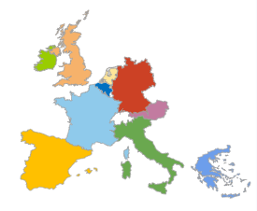



HERWINGT Community
Industry
RTO
University
SME
Associations

Slide 6
2. Introduction to LCA

Slide 7
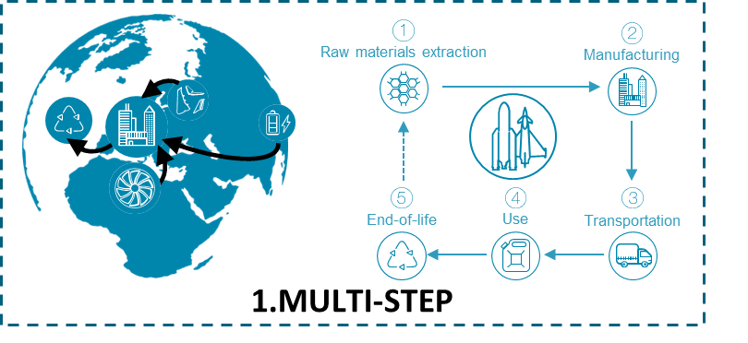
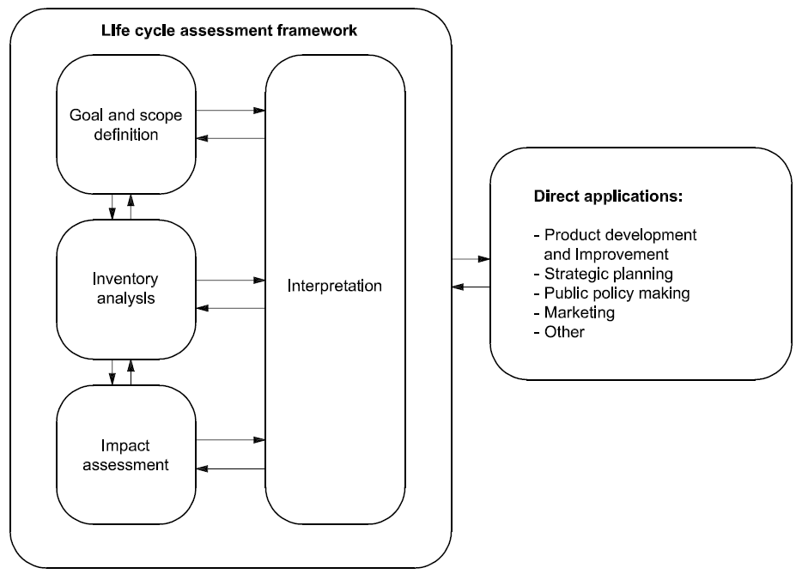
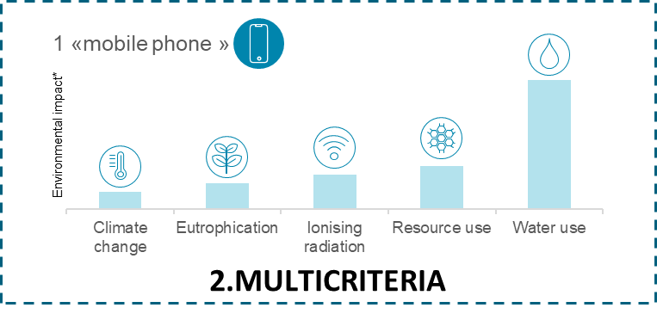
Introduction to LCA
Life Cycle Assessment is a science-based approach of assessing the potential environmental impacts of products or services during the entire life cycle
Framework based on ISO14040-44

Slide 8
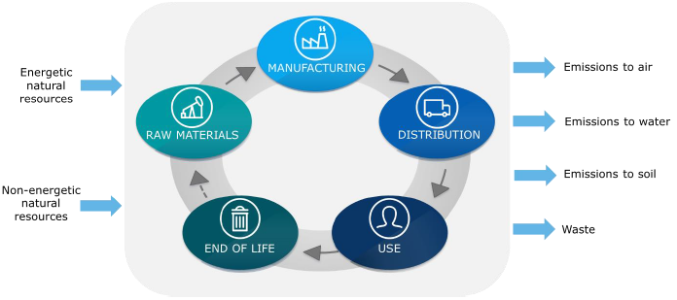




Introduction to LCA
Goal & Scope definition
Inventory Analysis
Impact assessment
Interpretation
EF: emission factor
<> Data collected / Data used
EF = emission / unit of interest
i.e.: (kgCO2eq) / (kg of material)
Impact Assessment, for GHG
= (kgCO2eq/kg) * (kg)
= kgCO2eq
Primary data
Supplier-specific
+ accuracy
+ collaboration
- difficult to obtain
Secondary data

Slide 9
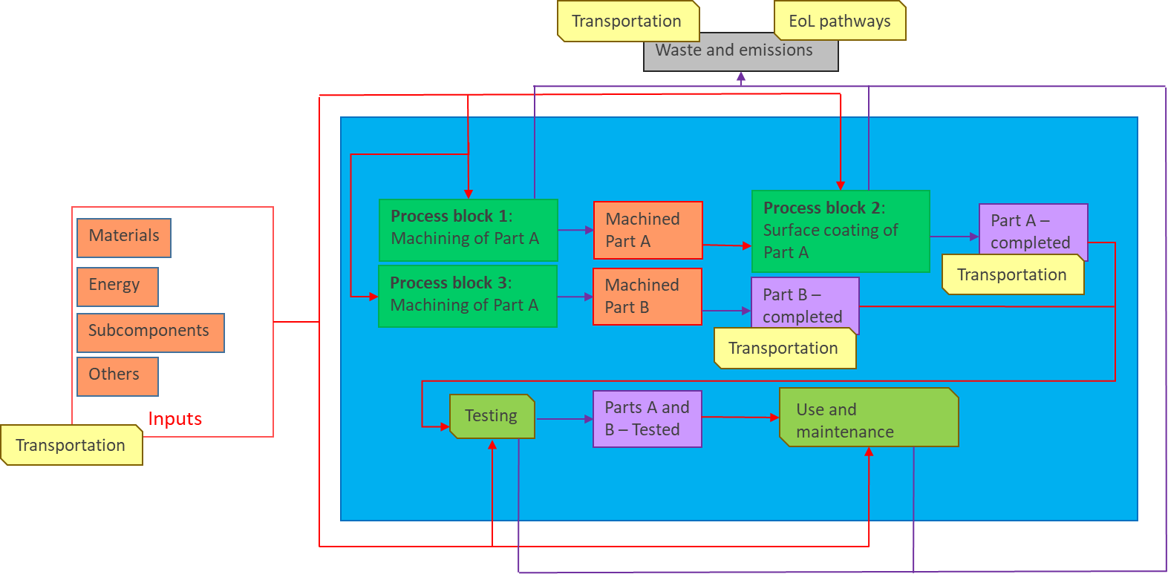
Introduction to LCA

Slide 10
3. WP9.1: Ecodesign and Data Collection

Slide 11
WP9.1: Ecodesign and Data Collection
M1-M36 (AD)
General objective
Deliver a life cycle assessment of the components, subsystems and full wing system compatible with the reference aircraft digital framework and requirements.
Perform a quantitative environmental impact assessment, in the form of Life Cycle Assessment (LCA) for a set of technologies and respective demonstrators developed in the frame of the Wing Design technical project (HER-04). The LCA activity will be followed based on the standard LCA methodology defined in ISO14040.
The LCA activity will be carried out at demonstrator level for 4 of the demonstrators proposed. The following criteria are proposed as suggestions to drive the selection of the demonstrators to be studied:
Goal of the demonstrator with respect to Clean Aviation project goals
Projects setup and inherent data availability
Maturity of projects - higher TRLs preferred, due to higher relevance of LCA when compared with low TRL
Timeline of the projects

Slide 12
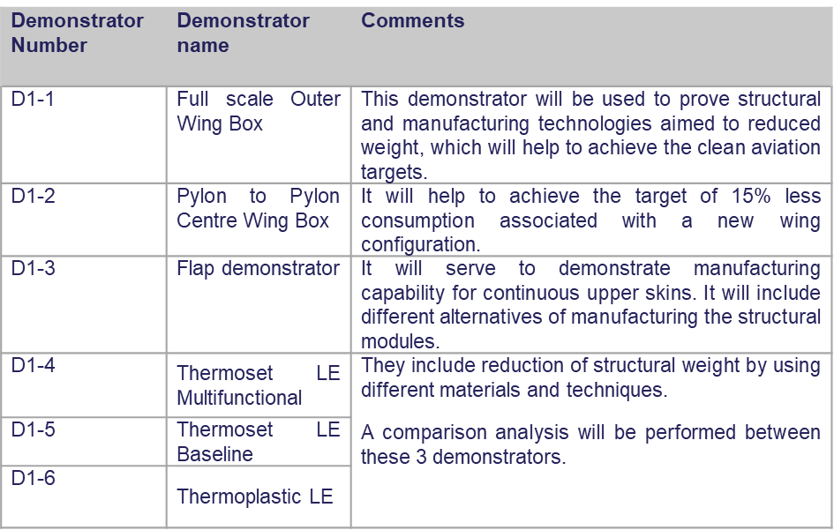
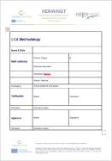
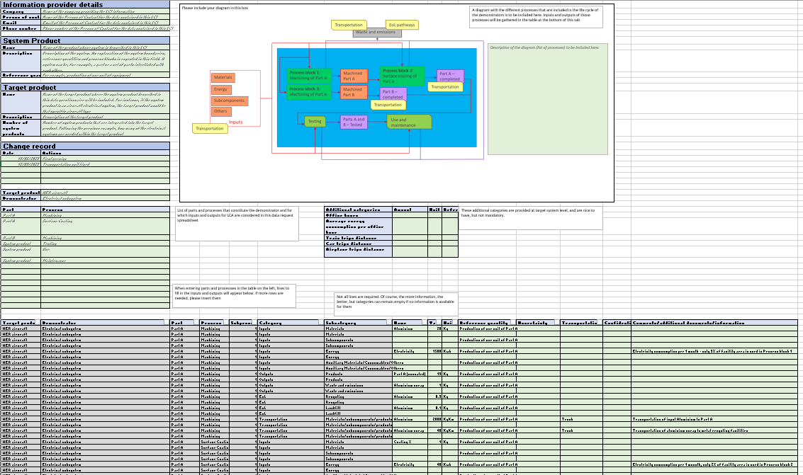
Achievements, status and next steps
concluded activities
on going activities
next steps
Milestones and Deliverables
Auxiliary activities
M32
(August 2025)
M35
(November 2025)
2023
June 2024
On-going
Life Cycle Inventory Data gathering template
Selection of the demonstrators for LCA
Life Cycle Assessment Methodology Report
First round of data collection and review
Models construction
Second round of data collection and review
Preliminary models construction
LC Data Collection from demonstrator manufacturing
Life Cycle Assessment for demonstrators
Notes:
SEP: Primary Distribution + Cables
CAI: Secondary distribution + power converters

Slide 13
4. Deep-dive into LCA

Slide 14
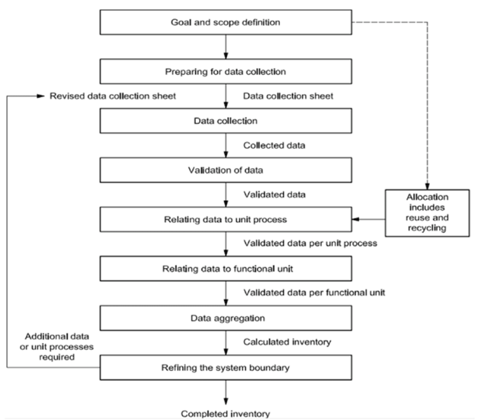
Deep-dive into LCA
Data Collection Procedure
DC I
R_DC
Aux_R
DC II
R_R_DC
DC III
Aux
LCI
LCA PM
LCA SM
...
LCA Methodology Writing
DC I | Data collection
R_DC | Data collection review
DC II | Second round of data collection
R_R_DC | Second round of review
DC III | Verified data collection
Aux | Auxiliary information requested
Aux-R | Auxiliary information reviewed
LCI | Life Cycle Inventory
LCA PM | LCA Preliminary Model
LCA SM | LCA Scaled Model

Slide 15
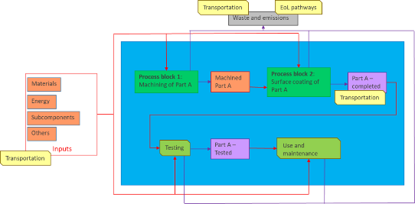
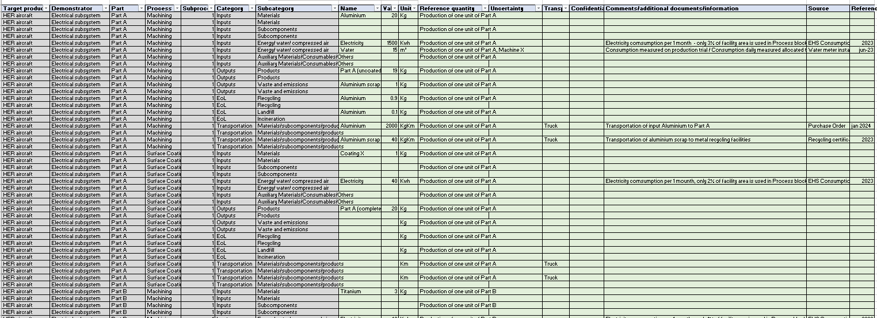
Deep-dive into LCA
Data Collection Procedure
Information section with information regarding:
The data provider
The system product
The target product
Change record
Product system diagram
List of individual process blocks that constitutes the system product, including information concerning:
Input materials and energy
Output products, waste, emissions to air/soil and wastewater
List of transportation steps affecting that process
A tab describing the final product (system product) obtained
Information regarding inputs and outputs used as part of any tests linked to the product (if applicable)

Slide 16
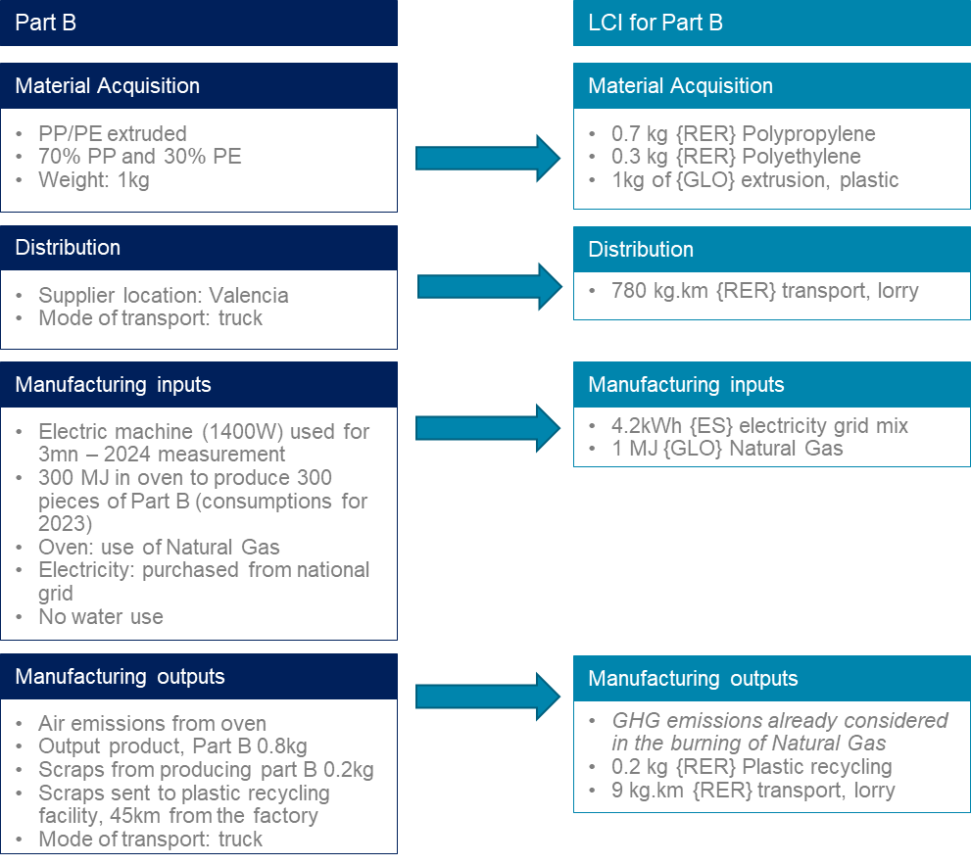
Deep-dive into LCA
Assumptions Guidance
How do we collect data on a product level?
What kind of data is considered accepted for LCA?
Where to get these data from?
What if data on specific processes are not available?
How do we go from Data Collection to an LCI?
How is data treated to compose the LCA Model?

Slide 17
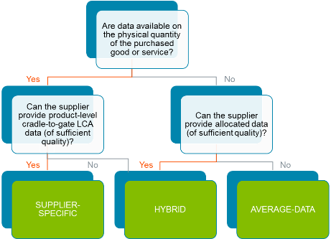

Deep-dive into LCA
Assumptions Guidance
Overall Assumptions
Material use and acquisition
Transportation
Manufacturing inputs – auxiliaries, testing, energy and water consumption
Manufacturing outputs – waste and emissions
Use and End of Life
Supporting material: ISO14040-44, GHG Protocol Scope 3, GHGP Product-level LCA, PEFCR Aircraft
Manufacturing inputs: If direct measurement is not possible, the accepted formats for calculation in this study are the following:
For thermal energy and electricity consumption: energy format (kcal, MJ or kWh) can be calculated through equations based on the time a material spends on a furnace/machinery, the specific temperature or voltage used by the furnace/machinery in order to function, and other relevant parameters to fulfil calorific/electric equations;
For water, thermal energy and electricity consumption: energy, weight and volume formats can use allocation if a consumption range of 12 months is available and can be associated to the number of parts produced (physical allocation) or the mass of materials produced (mass allocation). The data used should not be older than 2 years;
If none of the methods above can be applied, a similar process in Ecoinvent database can be selected to represent the manufacturing process
Hybrid:
- Activity data (quantities)
- Description of process + Ecoinvent matching process
- Proxy?
Different formats affect the data quality related to each input, which will contribute to lower or higher DQR.

Slide 18
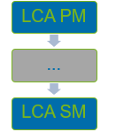
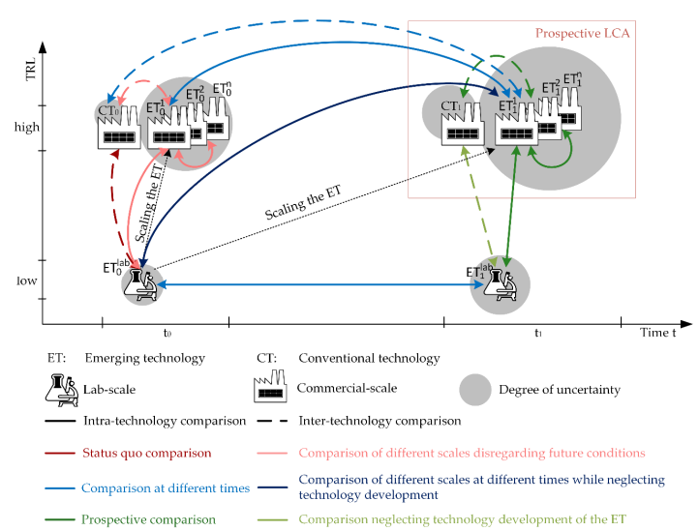
Deep-dive into LCA
Uncertainty and Scalability – Case Study D.1.5
(Thonemann, Schulte, & Maga, 2020)

Slide 19
Deep-dive into LCA
Case Study D.1.5 – Preliminary Results
ID | Description | Electricity usage (kWh) | Weight (kg) | GWP (kgCO2eq) | GWP reduction | Renewable contribution | Electricity increase
C1 | Test panel of 0.58*0.3 m² dimension (NON-RENEWABLE) | 160.433 | 0.8022 | 172.91 |  | 0% | -
1 | Test panel of 0.58*0.3 m² dimension | 160.433 | 0.8022 | 100.62 | -41.8% | 57% | -
2 | Test panel of 0.244*0.22 m² dimension | 160.433 | 0.2434 | 80.46 |  | 57% | -
C2 | Test panel of 0.244*0.22 m² dimension scaled to 0.8022kg | 528.76 | 0.8022 | 265.190 | +62.1% | 57% | +69.7%
- Method used: E.F. 3.1 > IPPC 2021 GWP100a
- C2 analysis
- Both pieces intake the same amount of electricity to be produced, in R&D grounds
Scaling for electricity is not obvious, and it can really dictate the results on the environmental assessment.
How would the oven capacity in the manufacturing ground delimit the production of the demonstrator?
How would the oven capacity in the manufacturing ground delimit the production of a full scale leading edge?
Can we produce multiple pieces in parallel?
How to reflect manufacturing line operation?

Slide 20
QA

Slide 21
Thank you!
Contact points for any question:
WP9 Coordination
Deborah Neumann de la Cruz (ADS) – WP9 and WP9.1 Leader
Email: deborah.d.neumann@airbus.com
Support
Vassiliki Vgenopoulou (EASN) – communication and dissemination
Email: vassiliki.vgenopoulou@easn.net
22/10/2024
- SENSITIVE/PUBLIC - GA 101101961

